Slide 1

50.039 Theory and Practice of Deep Learning W1-S1 Introduction
Matthieu De Mari

Slide 2

A quick word about instructors
Matthieu (Matt) De Mari
Lecturer at SUTD (Python, Deep Learning, AI, and more)
Information Systems Technology and Design (ISTD) pillar/faculty
PhD from CentraleSupelec (France)
Email: matthieu_demari@sutd.edu.sg
Office @ SUTD: 2.401.07

Slide 3
A quick word about TAs
XXX
XXX

Slide 4
Skills needed for this course
Must-have CS: Python, Numpy, Matplotlib.
Must-have Math: Linear Algebra, multiple variables calculus, derivatives, optimization probability and statistics.
Good-to-have CS: Machine Learning, Data Processing, Scipy, Sklearn.
Good-to-have Math: Graph Theory, Game theory.
Need to revise? Time to check your 10.014 CTD, 10.013 M&A, 10.018 MS&S, 10.022 MU, 10.020 DDW, and 50.007 ML.

Slide 5
Objectives of 50.039 DL
Introduce the technical aspects related to the implementation of Deep Neural Networks from scratch.
Teach the students about the most popular framework for implementing Deep Neural Networks (as of Jan 2023): PyTorch.
Discuss the mathematical foundations and intuitions behind the Deep Learning framework, layers and some techniques.
Give the students a global overview of the advanced techniques related to Deep Learning and Deep Neural Networks.
Describe examples of practical applications of Deep Learning, showing how some key AIs were implemented using Deep Learning.

Slide 6
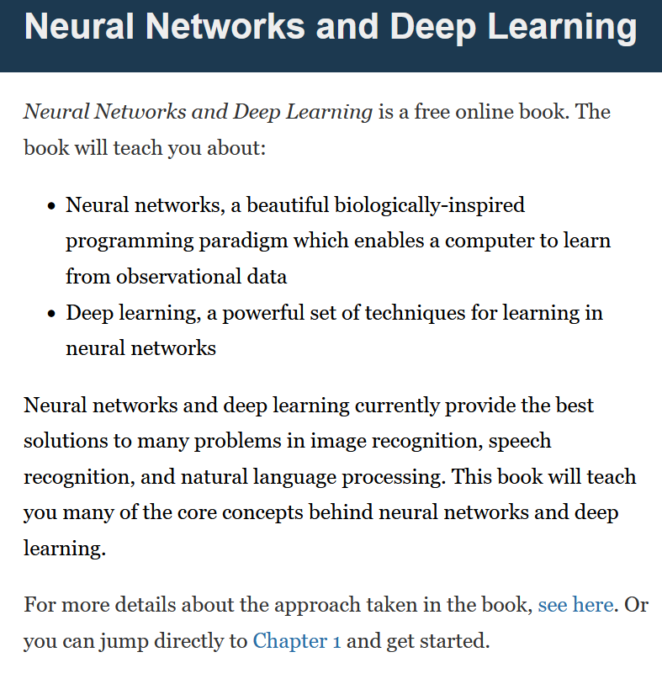
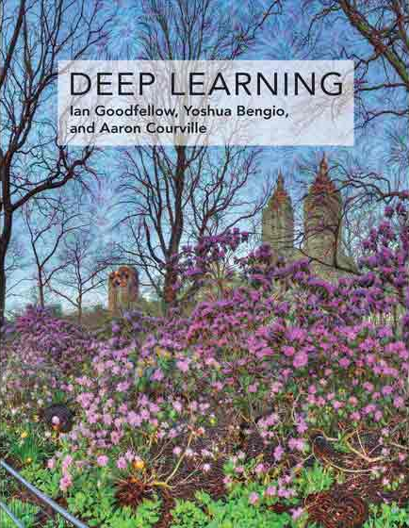

Supporting Textbooks
Supporting textbooks, for your curiosity (not needed to understand this course).
Michael A. Nielsen, “Neural networks and deep learning”, 2015. (http://neuralnetworksanddeeplearning.com/)
Ian Goodfellow, Yoshua Bengio and Aaron Courville, “Deep learning”, 2016. (https://www.deeplearningbook.org/)
Stevens et al., “Deep Learning with PyTorch”, 2020. (https://www.manning.com/books/deep-learning-with-pytorch)

Slide 7
Syllabus
Week 1: Introduction to course, some ML jargon reminders, linear and polynomial regression, generalization, ridge regression and regularization, overfitting/underfitting, logistic regression, neurons objects and how they relate to biology, our first shallow neural network, gradient descent reminders, training and testing procedure.
Week 2: Introduction to PyTorch framework, tensors and dataloaders, implementing a shallow neural network in PyTorch, backpropagation in PyTorch with AutoGrad, advanced optimizers, multi-label classification with shallow neural networks, moving from shallow to deep neural networks.

Slide 8
Syllabus
Week 3: Guided project and good practices for Deep Learning projects (train/test/dev, bias/variance, advanced regularization, dropout, normalizing inputs/outputs/layers, trainer functions, savers/loader functions for reproducibility and transfer learning).
Week 4: The image data type, image processing techniques and typical computer vision operations, the convolution operation and layers, Convolutional Neural Networks, advanced CNNs and SotA. Preparing transition to the 50.035 Computer Vision course.

Slide 9
Syllabus
Week 5: Sequential data (times series, text, etc.), vanilla Recurrent Neural Networks, Gated Recurrent Units, Long-Short Term Memory cells, advanced RNN networks, mixing models for advanced architectures and project announcement.
Week 6: Adversarial machine learning, attacking a Neural Network with basic gradient-based attacks, fundamental limits of Neural Networks, defense mechanisms and state-of-the-art of some advanced attacks techniques. MidTerm exam (based on W1-5).

Slide 10
Syllabus
Week 8: The embedding problem, more advanced concepts on RNNs, introduction to Natural Language Processing (NLP) and Word Embeddings for NLP, brief state-of-the-art on NLP, attention and transformers architectures. Preparing transition to the 50.040 Natural Language Processing course.
Week 9: Quick introduction to Graph Theory and typical graph datasets and problems, basics of Graph Convolutional Networks, brief state-of-the-art of advanced Graph Convolutional Networks.

Slide 11
Syllabus
Week 10: Generative Models, Autoencoders and Variational Autoencoders, Generative Adversarial Networks (GANs), Advanced concepts on Generative Adversarial Networks, Practice on GANs.
Week 11: Brief introduction to reinforcement learning, and state-action-rewards systems, multi-armed bandit problem and the exploration/exploitation trade-off, Q-learning and Deep Q-Learning. Brief state-of-the-art discussion about further works in Reinforcement Learning.

Slide 12
Syllabus
Week 12: Explainability/Interpretability and open questions in research about Neural Networks. Deep belief models and diffusion models. Closing of the course and future directions for studying Deep Learning.
Week 13: Project presentations and guest conferences (TBA).
Week 14: Final exam (probably W1-13).

Slide 13
The way I teach things

Slide 14
Evaluation and grading
Homeworks (29%): Given on Weeks 2, 5, 8, 10. Usually come in the form of a Jupyter Notebook, containing explanations, code snippets and questions. Submissions on eDimension, two weeks later or so, as a small PDF report containing code, figures and answers to questions. When time allows, debrief of homeworks in class.
MidTerm Exam (20%): Given on Week 6, March 1st 2023. Theoretical, paper exam, notions of Week 1-5 to be tested. More details about venue and exam details to be announced closer to the exam date.

Slide 15
Evaluation and grading
Final Exam (20%): Given on Week 14, April 26th 2023. Theoretical, paper exam, notions of Week 1-13 to be tested. More details about venue and exam details to be announced closer to the exam date.
Project (29%): Groups of 2-3 students. Submission for project (code, report, presentation) expected on Week 13. Problem statement to be freely decided by students, as long as it matches a list of given requirements. We will have a guided demo project on Week 3, more details about the project will be given on Week 5.
Student Feedback Survey (2%): the usual.

Slide 16



Technical pre-requisites
Install Python 3, if you have not done so already (this course does not cover C++/Java).
Libraries needed (maybe more based on projects/homeworks): numpy, matplotlib, scipy, sklearn, networkx, pillow, gym.
Jupyter notebooks for demos of code, along with the slides.
In doubt, you can always use Google Colab to run the codes.

Slide 17

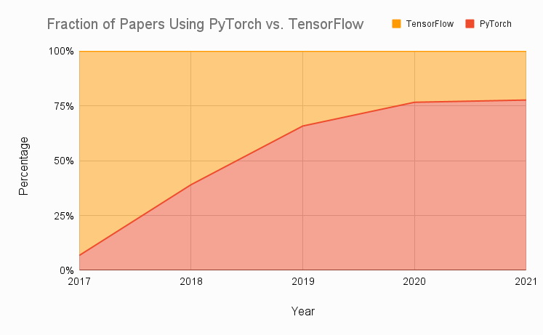
Technical pre-requisites
Framework of choice will be PyTorch! (not Tensorflow, not Keras, not MXNet, etc.)
Increasing popularity and preferred to Google’s Tensorflow these days for many reasons.
Learn more, if curious: https://www.assemblyai.com/blog/pytorch-vs-tensorflow-in-2022/

Slide 18
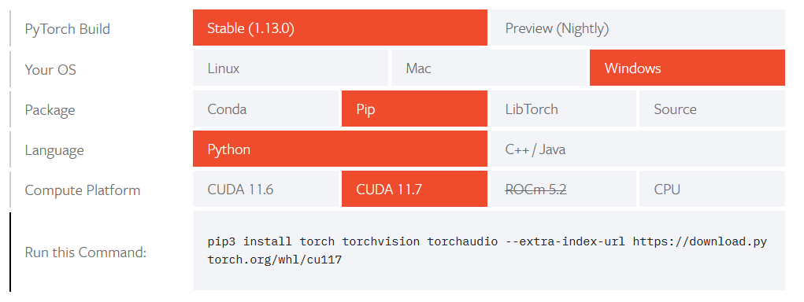
Installing PyTorch and CUDA
Install PyTorch, by getting the right version from https://pytorch.org/get-started/locally/

Slide 19
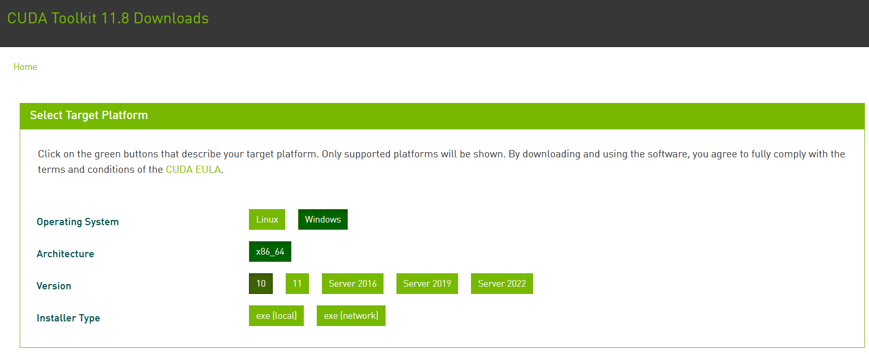
Installing PyTorch and CUDA
Check if your GPU is in the list of acceptable GPUs. https://developer.nvidia.com/cuda-gpus
If so, install CUDA (check version number matches PyTorch install!) https://developer.nvidia.com/cuda-downloads

Slide 20
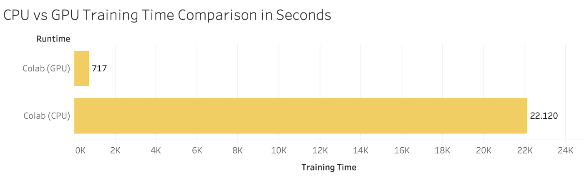

Installing PyTorch and CUDA
GPU not in the list of CUDA-enabled GPUs? Most notebooks can still run on CPU (but they might take significantly longer).
Always the option of using Google Colab, or create an education account on AWS.

Slide 21
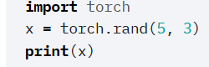
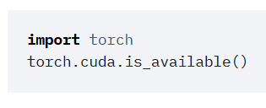
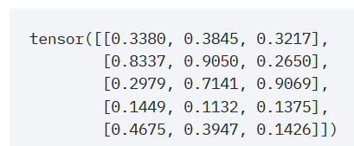
Checking your PyTorch and CUDA install
Hello World for PyTorch: to check you have PyTorch installed correctly. The code below should run and display a tensor.
Hello World for CUDA: to check you have correctly installed CUDA on top of PyTorch. The code below should print True, as the output of torch.cuda.is_available()

Slide 22
About this week (Week 1)
XXX

Slide 23
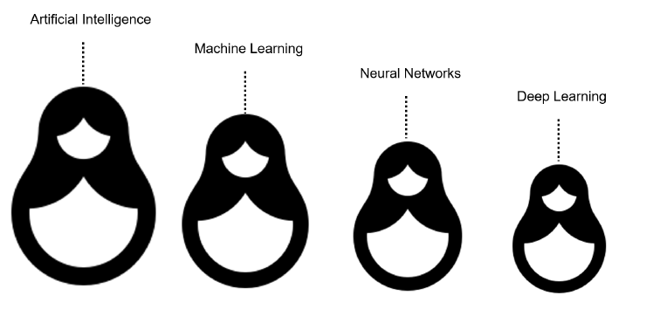
What is AI/ML/NN/DL?
Artificial intelligence
Machine Learning
Neural Networks
Deep Learning
Definition (Artificial Intelligence):
“In Computer Science, Artificial Intelligence (AI) refers to the theory and development of computer systems capable to perform cognitive tasks that normally require human intelligence, such as visual perception, speech recognition, decision-making, and translation between languages.”

Slide 24
What is AI/ML/NN/DL?
Conventional programming
Definition (Machine Learning):
In Computer Science, Machine Learning (ML) refers to the field of study that describes techniques and algorithms that give computers the ability to learn without being explicitly programmed.
Some implementations of machine learning may rely on data and neural networks.
- Arthur Samuel (1959).
Input (Given)
Function
(Created)
Output
(Obtained)
VS.
Machine Learning
Input (Available)
Function
(?)
Output
(Available)

Slide 25
What is AI/ML/NN/DL?
What we have done in programming so far was to design functions,
which would do specific operations,
and return outputs,
for any input we could give it.
But sometimes, we can encounter problems where
we can easily find inputs and expected outputs,
but the function to be coded is not simple to figure out.
E.g., what animal is in the picture?
Input (Given)
Function
(Created)
Output
(Obtained)
Input (Available)
Function
(?)
Output
(Available)

Slide 26

What is AI/ML/NN/DL?
E.g., what animal is in the picture?
Typical problem in Computer Vision, called Image Recognition.
Input x (available)
Function f
(?)
Output y = f(x)
(available)
It’s a cat!

Slide 27
What is AI/ML/NN/DL?
E.g., what animal is in the picture?
Typical problem in Computer Vision, called Image Recognition.
Input x (available)
Function f
(?)
Output y = f(x)
(available)
Very easy for a human…
But, how would we do it with a computer?
It’s a cat!

Slide 28
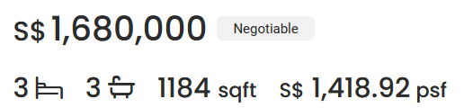
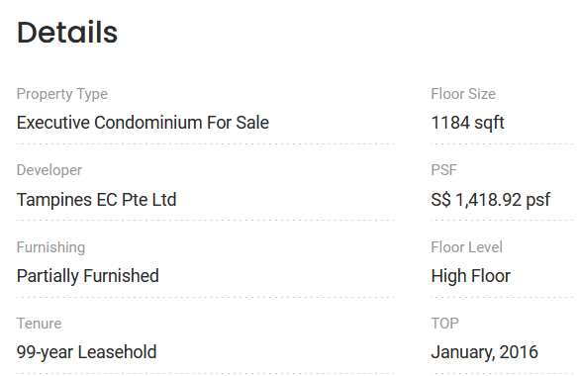

What is AI/ML/NN/DL?
Other scenarios of difficult functions have to do with tasks where there is no easy closed-form expression connecting inputs to outputs.
E.g., what is a good selling price for my appartment?
Guessing the selling price of an appartment based on its parameters (size, location, etc.) and previous sales.

Slide 29
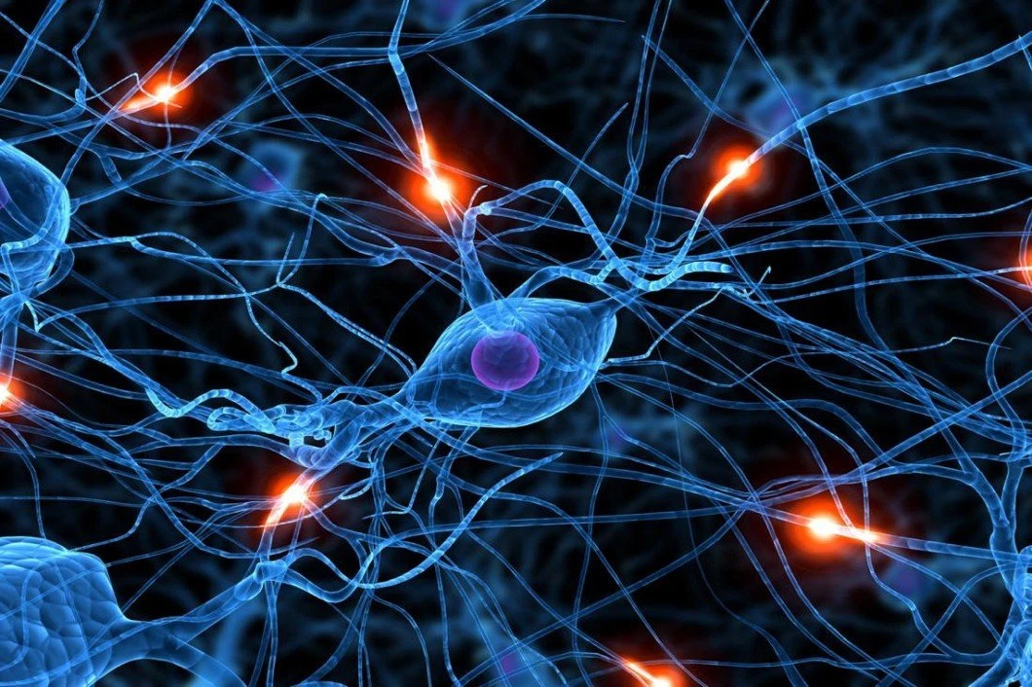
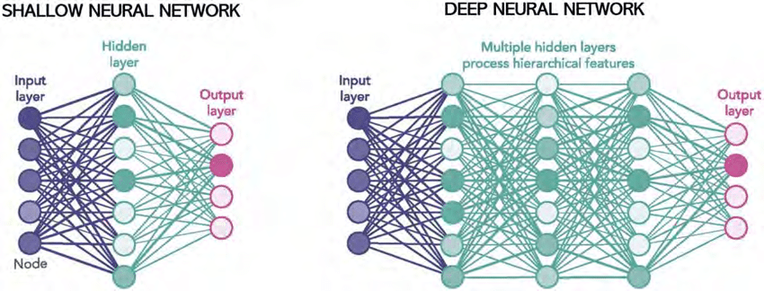
What is AI/ML/NN/DL?
Definition (Neural Networks):
Neural Networks (NNs) are computing systems inspired by the biological neural networks that constitute animal brains.
NNs are based on a collection of connected units or nodes called artificial neurons, which loosely model the neurons in a biological brain.

Slide 30
What is AI/ML/NN/DL?
Definition (Neural Networks):
Neural Networks (NNs) are computing systems inspired by the biological neural networks that constitute animal brains.
NNs are based on a collection of connected units or nodes called artificial neurons, which loosely model the neurons in a biological brain.
Each connection, like the synapses in a biological brain, can transmit a signal to other neurons, therefore processing any information given as inputs to produce a final signal as output.

Slide 31
What is AI/ML/NN/DL?
Definition (Deep Learning):
Deep Learning (DL) is a subfield of machine learning, and deep neural networks make up the backbone of deep learning algorithms.
The number of node layers, or depth, of neural networks is what distinguishes a shallow neural network from a deep neural network, which must have more than three.

Slide 32
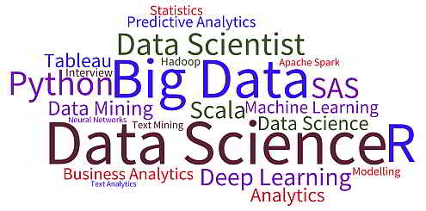
What is AI/ML/NN/DL?
Artificial intelligence
Machine Learning
Neural Networks
Deep Learning

Slide 42
Conclusion (W1S1)
XXX
XXX

Slide 43
Learn more about these topics
Out of class, supporting papers, for those of you who are curious.
[XXX] XXX

Slide 44
Learn more about these topics
Some extra (easy) reading and videos for those of you who are curious.
[XXX] XXX

